Slide 1
Software Engineering Concepts (CSC205) BSCS/BS(SE)-III gg
Lecture 3

Slide 2
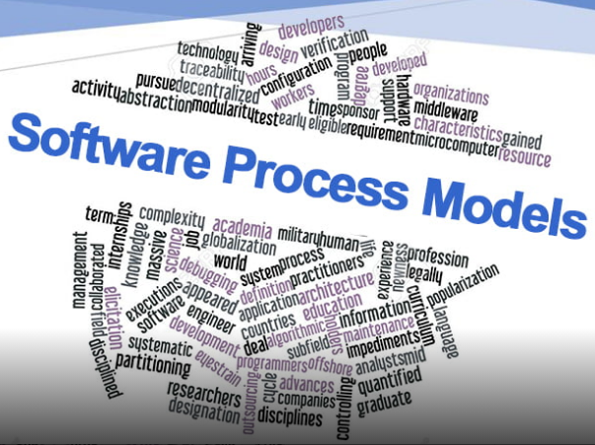
Agenda
Process Model
Introduction
Traditional
Incremental

Slide 3

Software Engineering
Some realities:
A concerted effort should be made to understand the problem before a software solution is developed.
Design becomes a pivotal activity.
Software should exhibit high quality.
Software should be maintainable.
The seminal definition:
[Software engineering is] the establishment and use of sound engineering principles in order to obtain economically software that is reliable and works efficiently on real machines.

Slide 4
Factors affecting the quality of a software system
Complexity:
The system is so complex that no single programmer can understand it anymore.
The introduction of one bug fix causes another bug,
Change:
The “Entropy” of a software system increases with each change:
Each implemented change erodes the structure of the system which makes the next change even more expensive (“Second Law of Software Dynamics”).
As time goes on, the cost to implement a change will be too high, and the system will then be unable to support its intended task. This is true of all systems, independent of their application domain or technological base.

Slide 5
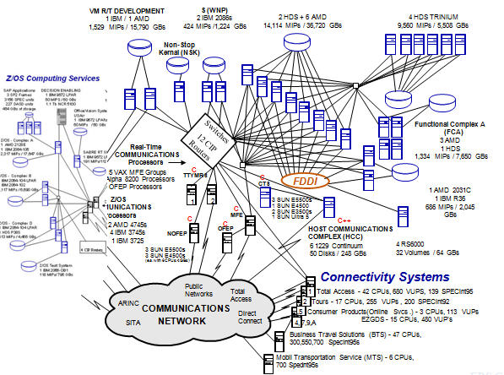
Complex Server Connections

Slide 6
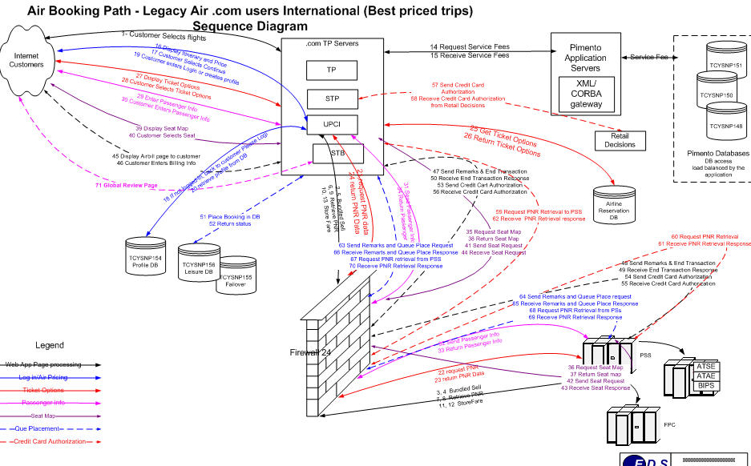
Complex Message Flow

Slide 7
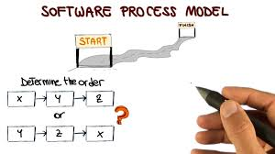
Software Process
Process
A set of (ordered) activities.
Software Process
A structured set of activities required to develop a software system.
The roadmap to build high quality software products.
"If you don't know where you're going, any road won’t help you.“
"If you don't know where you are, a map won't help you."

Slide 8
What is a Software Process?
SW Process Activity | What is going on there?
Specification | What does the customer need? What are the constraints?
Development | Design & programming.
Validation | Checking whether it meets requirements.
Evolution | Modifications (e.g. customer/market).
Activities and results that produce a software product:

Slide 9
Software Process Model…
What is a model?
A model is a simplification of reality. We model because we cannot comprehend the complexity of a system in its entirely.
Software Process Model
An abstract representation of a software process.
It presents a description of a process from some particular perspective.

Slide 10
Software Process Model…
Description of the software process that represents one view, such as the activities, data or roles of people involved.
Examples of views | Focus on…
Workflow | Activities = human actions. What is input, output, and dependencies.
Dataflow | Activities = transformations of information. How the input is transformed into output.
Role/Action | What is the role of people involved in each step of the process?

Slide 11
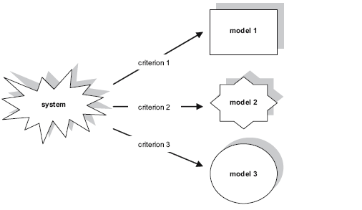
The Multiple View Approach

Slide 12
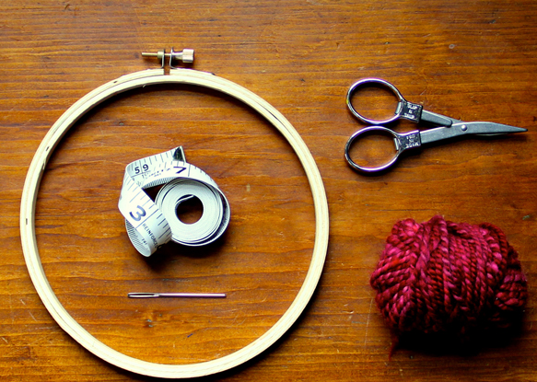
Product and Process
The quality of a software product is largely governed by the quality of the software process used to develop and maintain it.

Slide 13
Process: A Generic View
A software process
Is a roadmap to build high quality software products.
Provides a framework for managing activities.
Adapt to meet needs of software engineers and managers.
Different types of projects require different software processes.
Best indicators of how well a process worked are the quality, timeliness, and long-term viability of the resulting software product.
When a process involves building a software, the process may be referred to as software life cycle.

Slide 14
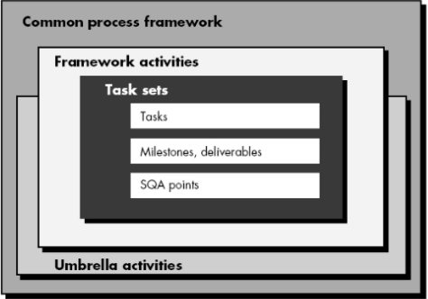
A Generic Process Framework

Slide 15
Framework Activities
Communication
Planning
Modeling
Analysis of requirements
Design
Construction
Code generation
Testing
Deployment

Slide 16
Umbrella Activities
Software project management
Formal technical reviews
Software quality assurance
Software configuration management
Work product preparation and production
Reusability management
Measurement
Risk management

Slide 17
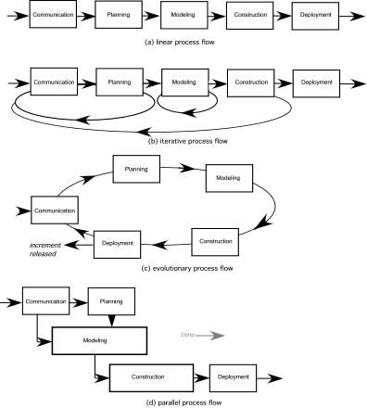
Process Flow

Slide 18
Process Flow
Linear process flow executes each of the five activities in sequence.
An iterative process flow repeats one or more of the activities before proceeding to the next.
An evolutionary process flow executes the activities in a circular manner. Each circuit leads to a more complete version of the software.
A parallel process flow executes one or more activities in parallel with other activities ( modeling for one aspect of the software in parallel with construction of another aspect of the software.

Slide 19
The Essence of Practice
How to develop a quality software?
Polya suggests:
1. Understand the problem (communication and analysis).
2. Plan a solution (modeling and software design).
3. Carry out the plan (code generation).
4. Examine the result for accuracy (testing and quality assurance).

Slide 20
1. Understand the Problem
Who has a stake in the solution to the problem? That is, who are the stakeholders?
What are the unknowns? What data, functions, and features are required to properly solve the problem?
Can the problem be compartmentalized? Is it possible to represent smaller problems that may be easier to understand?
Can the problem be represented graphically? Can an analysis model be created?

Slide 21
2. Plan the Solution
Have you seen similar problems before? Are there patterns that are recognizable in a potential solution? Is there existing software that implements the data, functions, and features that are required?
Has a similar problem been solved? If so, are elements of the solution reusable?
Can subproblems be defined? If so, are solutions readily apparent for the subproblems?
Can you represent a solution in a manner that leads to effective implementation? Can a design model be created?

Slide 22
3. Carry Out the Plan
Does the solution conform to the plan? Is source code traceable to the design model?
Is each component part of the solution provably correct? Has the design and code been reviewed, or better, have correctness proofs been applied to algorithm?

Slide 23
4. Examine the Result
Is it possible to test each component part of the solution? Has a reasonable testing strategy been implemented?
Does the solution produce results that conform to the data, functions, and features that are required? Has the software been validated against all stakeholder requirements?

Slide 24
Software Process (Life-Cycle) Models
Water Fall
RAD
Incremental
Prototyping
Spiral
Win-Win Spiral
RUP
Agile
XP
SCRUM

Slide 25
Software Process Models
The waterfall model
Plan-driven model. Separate and distinct phases of specification and development.
Incremental development
Specification, development and validation are interleaved. May be plan-driven or agile.

Slide 26
The Waterfall Model
One of the first process development models proposed.
Works for well understood problems with minimal or no changes in the requirements.
Simple and easy to explain to customers.
It presents
a very high-level view of the development process
sequence of process activities
Each major phase is marked by milestones and deliverables (artifacts)

Slide 27
The Waterfall Model

Slide 28
Waterfall Model Phases
There are separate identified phases in the waterfall model:
Requirements analysis and definition
System and software design
Implementation and unit testing
Integration and system testing
Operation and maintenance
The main drawback of the waterfall model is the difficulty of accommodating change after the process is underway. In principle, a phase has to be complete before moving onto the next phase.

Slide 29
Waterfall Model…
Advantages
Built-in documentation and quality assurance at each stage.
Standard procedure and techniques.
Better control over development.
Feedback statistics for future projects.
Documentation.
Disadvantages
Heavy demand on client/users in testing each stage.
Reluctance of clients to commit to sign-off.
Reluctance of developer to alter signed off requirements.
Real projects rarely follow the sequential flow that the model proposes.
It is often difficult for the customer to state all requirements explicitly.
The customer must have patience.

Slide 30
Waterfall Model Problems
Provides no guidance how to handle changes to products and activities during development (assumes requirements can be frozen).
Therefore, this model is only appropriate when the requirements are well-understood and changes will be fairly limited during the design process.
Views software development as manufacturing process rather than as creative process.
There is no iterative activities that lead to creating a final product.
Long wait before a final product.

Slide 31
The Incremental Model
It combines elements of the waterfall model applied in an iterative fashion.
Each linear sequence produces deliverable “INCREMENTS” of the S/W.
E.g., Word Processing S/W
First increment (Basic file management, editing, and document production functions)
Second increment (More sophisticated editing, and document production capabilities)
Third increment (Spelling and grammar checking)
Fourth increment (Advance page layout capability)

Slide 32
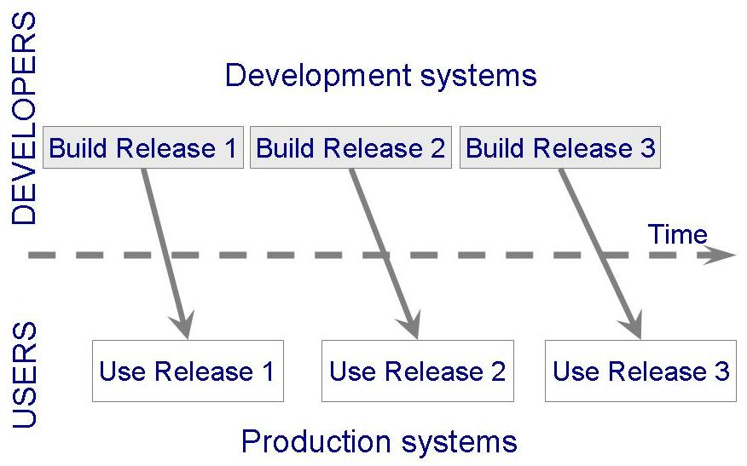
The Incremental Model…
Shorter cycle time
System delivered in pieces
enables customers to have some functionality while the rest is being developed
Allows two systems functioning in parallel
the production system (release n): currently being used
the development system (release n+1): the next version

Slide 33
The Incremental Model

Slide 34
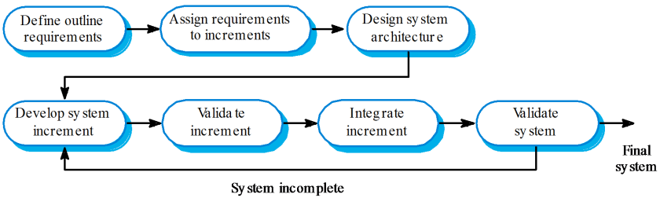
Incremental Model

Slide 35
Incremental Development Benefits
The cost of accommodating changing customer requirements is reduced.
The amount of analysis and documentation that has to be redone is much less than is required with the waterfall model.
It is easier to get customer feedback on the development work that has been done.
Customers can comment on demonstrations of the software and see how much has been implemented.
More rapid delivery and deployment of useful software to the customer is possible.
Customers are able to use and gain value from the software earlier than is possible with a waterfall process.

Slide 36
Incremental Development Problems
The process is not visible.
Managers need regular deliverables to measure progress. If systems are developed quickly, it is not cost-effective to produce documents that reflect every version of the system.
System structure tends to degrade as new increments are added.
Unless time and money is spent on refactoring to improve the software, regular change tends to corrupt its structure. Incorporating further software changes becomes increasingly difficult and costly.

Slide 37
References
Software Engineering, Sommerville, I., Chapter 1, 10th Edition (2016), Pearson.
Software Engineering: A Practitioner’s Approach, Pressman, R.S. & Maxim B., Chapter 2, 8th Edition (2015), McGraw-Hill.

